Slide 1

APPLICATION WEBSITE FOR NAUKRI

Slide 2

AIM
TO ANALYSE E-COMMERCE APPLICATION FOR NAUKRI

Slide 3
Requirement for e-job portals
Internet connection
e-mail ID
LOGIN –user ID\user name
valid password
graduation

Slide 4
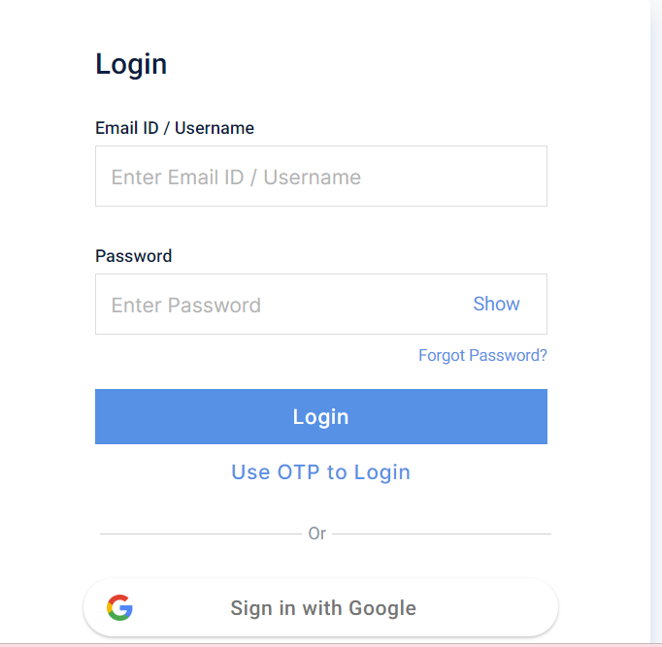

Slide 5
Positive test scenario
Enter valid user name.
Enter valid password.
Click on forget password link and forget password page.
Click on create new account button and verify if it takes to new account page.
Select keep the signed in option to retain login session.
Need internet connection ,done only by online.
Need to do work in online from home.
Flexible schedule and work areas.
Increased the productivity.
Spend more time with family.

Slide 6
Negative test scenario
Enter invalid user name and valid password.
Enter valid username and invalid password.
Less reliable internet connection is a problem.
Is concerns on cyber security.
Lacl of /less collaboration.
Not for everyone only for loneliness.
Fail to login the application.
Enter invalid user name and password.
Keep one field blank either username or password and check login.
Lack of internet connection.

Slide 7
Test cases
Test cases | Type – negative/positive Test case
Verify if a user will be able to login with valid username and valid password. | Positive
Verify the forget password functionality | Positive
Verify the remember me functionality. | Positive
Verify if the data in password field is either visible as asterisk bullet signs. | Positive
verify if a user cannot enter the characters more than the specified range in each field. | Positive

Slide 8
Test cases | Type – negative/positive Test case
Verify if a user cannot login with a valid username and an invalid password. | Negative
Verify the login page for both ,when the field is blank and submit button is clicked. | Negative
Verify if a user should not be allowed to login with different credentials from the same browser at the same time. | Negative
Verify the login page against SQL injection attack | Negative
Verify the use can login in different systems at a time | Negative

Slide 9
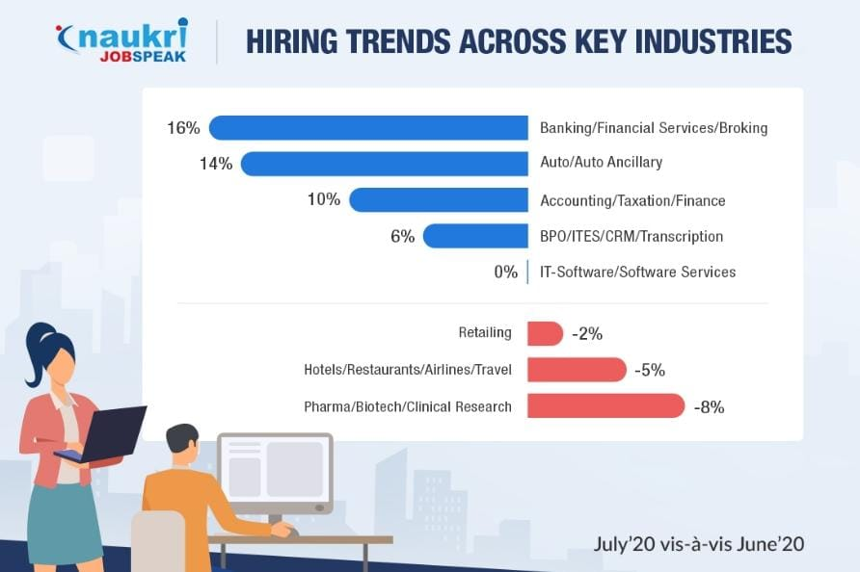


Slide 10
conclusion
I have navigate the Naukri web application and find out the positive / pass and negative / fail test cases. This is to improve the application performance in better manner.

Slide 11


